Slide 1
Electronics & Electricity
Unit 2 – Electric Circuits and Devices
Section 2 – Conductance and Resistance

Slide 2
Electric Circuits and Devices
Conductance and Resistance

Slide 3
Google classroom code
1c62ger

Slide 4
The big idea
Define the terms conductor and insulator
Describe certain types of resistors
Sketch an illustration of electrons flowing through a wire
Determine the resistance value by resistor color code
Electrons flow differently by the kinds of materials in the circuit

Slide 5
Terms
Conductor
Insulator
Ohm
Potentiometers
Resistance
Resistor
Tolerance

Slide 6
Conductors
A material through which electrons flow easily
3 good electrical conductors are:
Silver
Copper
Aluminum
* Metals are generally good conductors

Slide 7
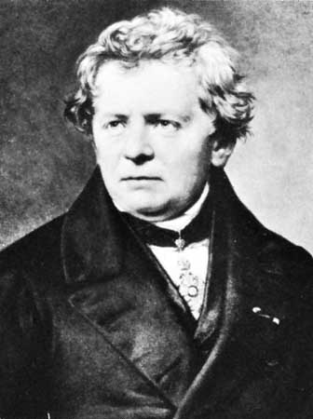
Resistance
An opposing force between one thing and another
The unit of resistance is the OHM
Names of Georg Simon Ohm (1787-1854)
A german physicist
The symbol for resistance is R

